Slide 1
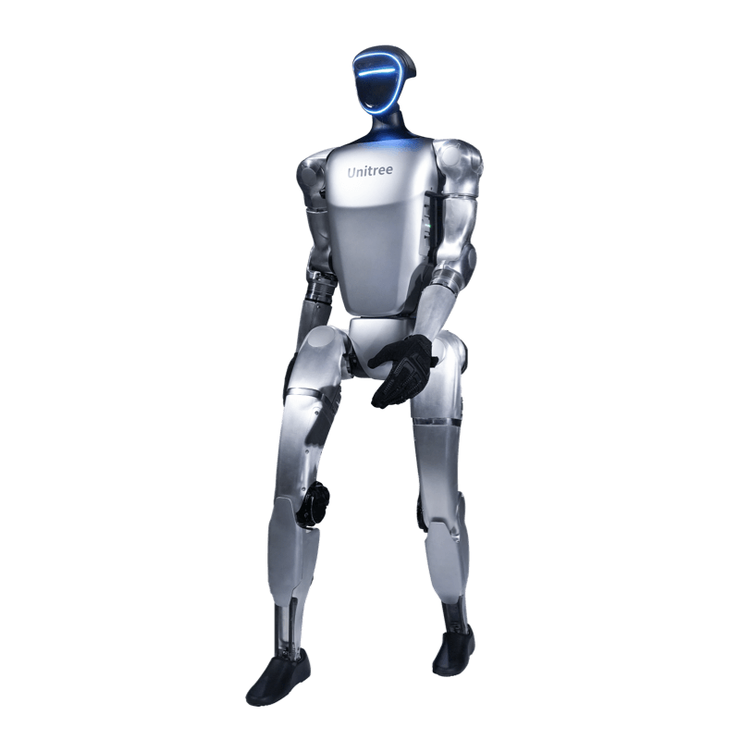
From RL to robotics
A hands-on crash course in
making robots move
90 minutes · RL → robotics
INTRODUCTION / 1 OF 51
Notes:
0–0.5 min (0.5 min).
This is a robotics crash course for PhD students after four days of RL. The 90-minute lecture introduces the decisions between a policy and a moving robot. The separate five-hour practical gives students a first experience of changing and testing a controller. No submissions or grading: the experiments are for their own learning. Aim for curiosity and a feel for what is possible, not mastery of robotics in one day. Opening Unitree demonstration GIFs are motivation, not course results.

Slide 2
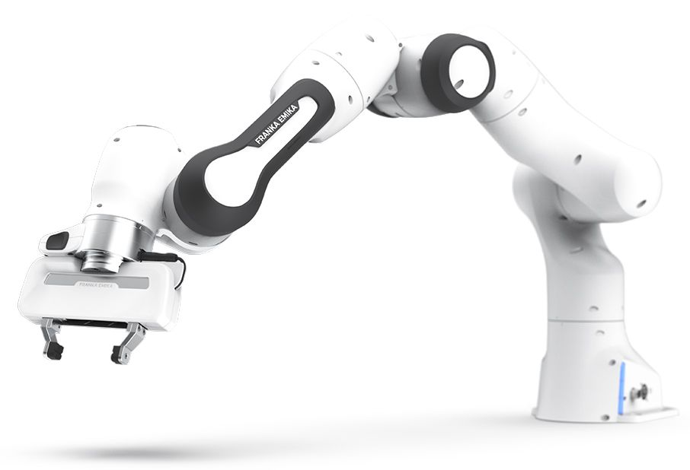
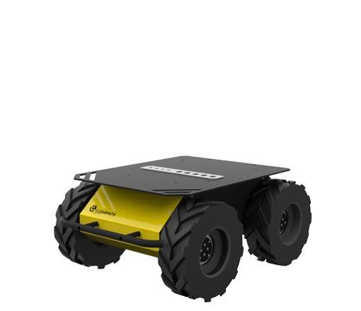
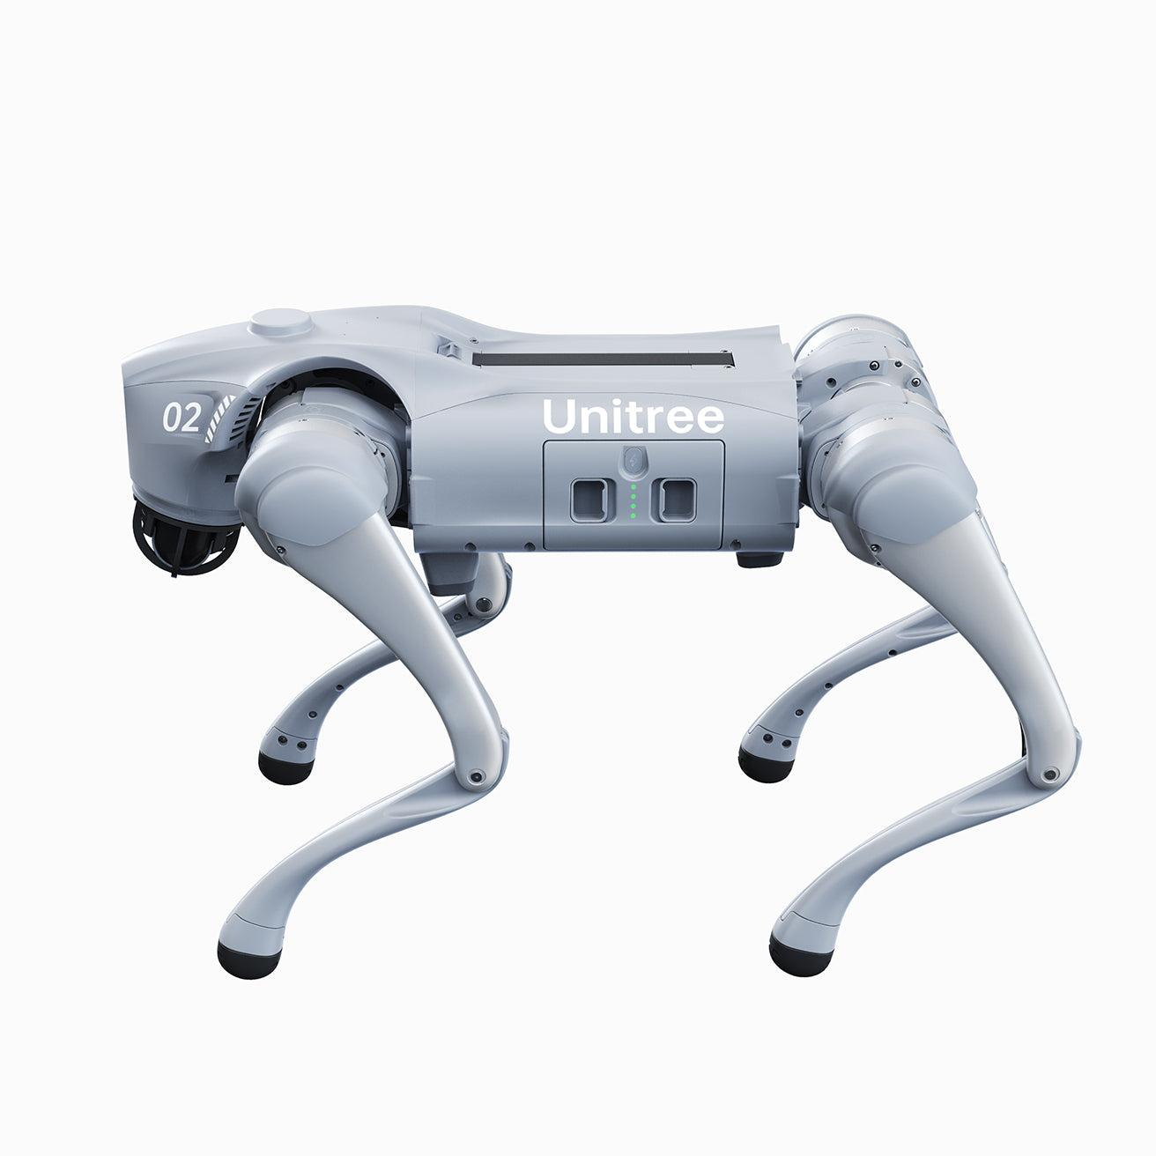
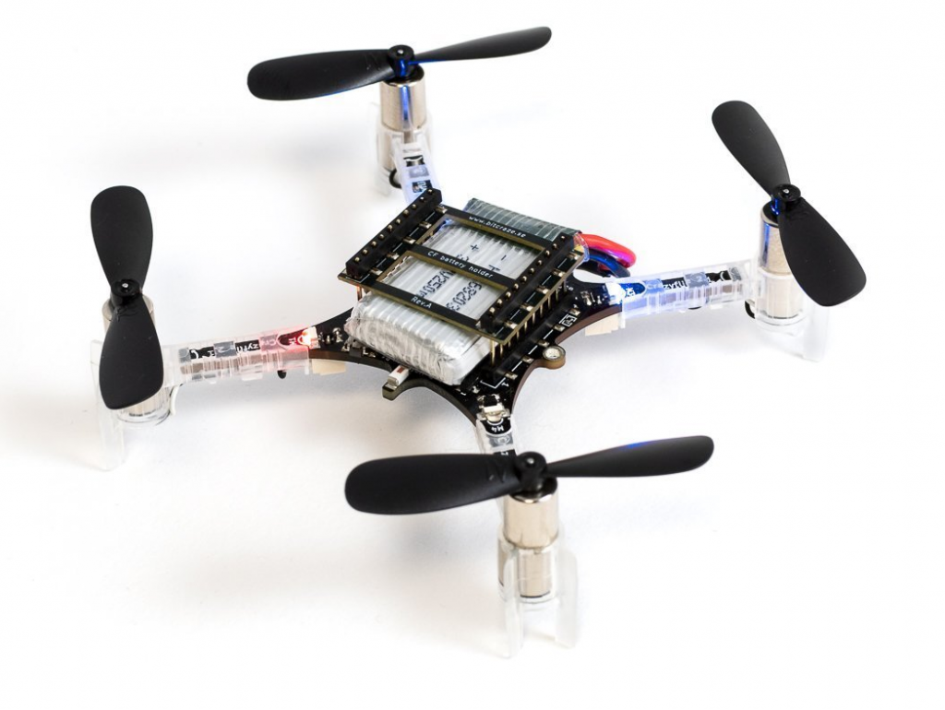
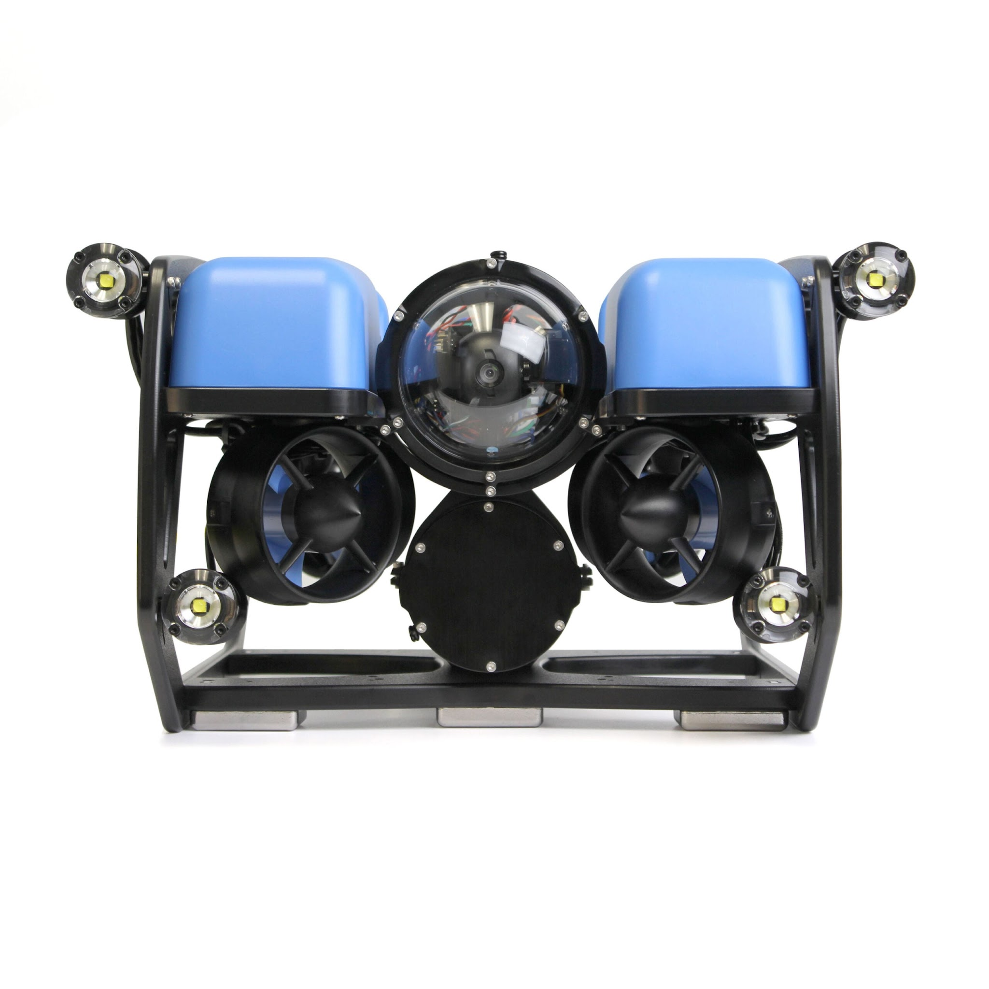
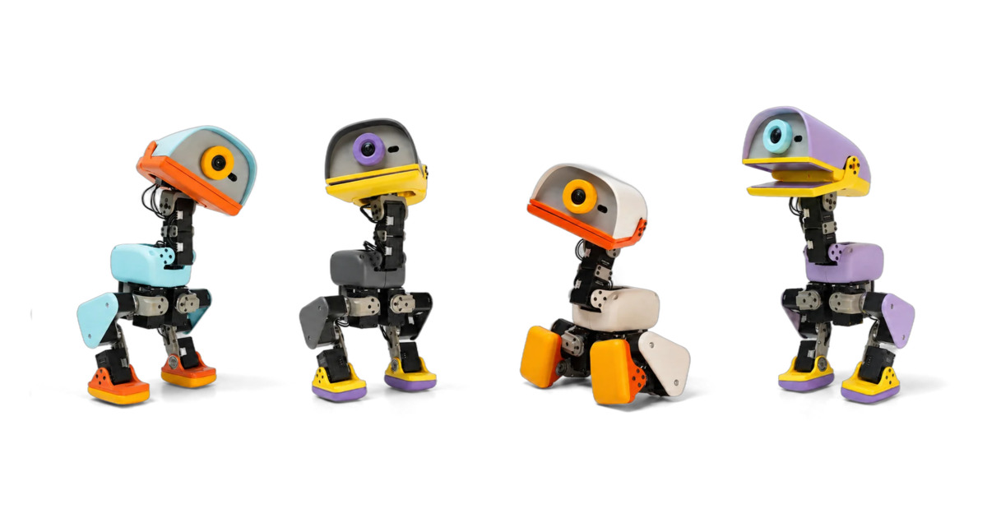
Robotics comes in many forms
Robot arms
Wheeled robots
Quadrupeds
Humanoids
Flying robots
Underwater robots
Microduck · small biped
Images: GRASP Lab · Waterloo · Unitree · Bitcraze · Blue Robotics · Pollen Robotics
A ROBOTICS OVERVIEW / 2 OF 51
Notes:
0.5–1 min (0.5 min).
Robots differ in body structure, support, and environment. This is a visual overview, not an exhaustive taxonomy or a ranking of task difficulty. Microduck is Pollen Robotics’ small biped. The underwater example is a BlueROV2, a remotely operated vehicle. Next narrow to fixed-base arms, quadrupeds, and humanoids to explain increasing balance and whole-body coupling. Photos are not to scale. Sources: https://grasplab2022.github.io/ ; https://uwaterloo.ca/robohub/ ; https://shop.unitree.com/ ; https://www.bitcraze.io/ ; https://bluerobotics.com/ ; https://pollen-robotics.com/microduck/

Slide 3
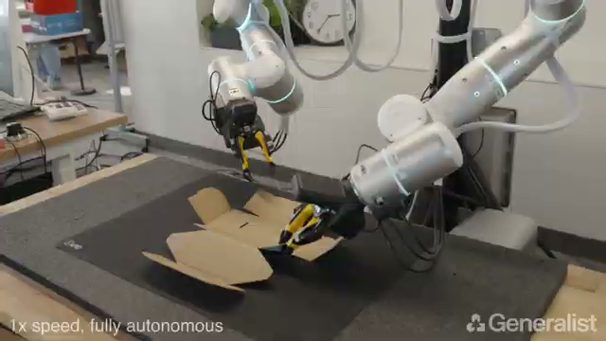
Fixed-base robots: learn to manipulate
Generalist · GEN-1 · autonomous box folding · 1×
A ROBOTICS OVERVIEW / 3 OF 51
Notes:
1–2 min (1 min).
Start with the video, not a taxonomy. The arms are mounted to a fixed support. The robot still needs perception, dexterous coordination, and feedback, but does not need to balance a free-moving base. This is a progression in balance and whole-body coupling, not a claim that every arm task is easier than every walking task. Generalist describes GEN-1 as an embodied foundation model, with human-interaction pretraining and robot adaptation. Do not label it a conventional VLA or claim it is a WAM. Source: https://generalistai.com/blog/gen-1

Slide 4
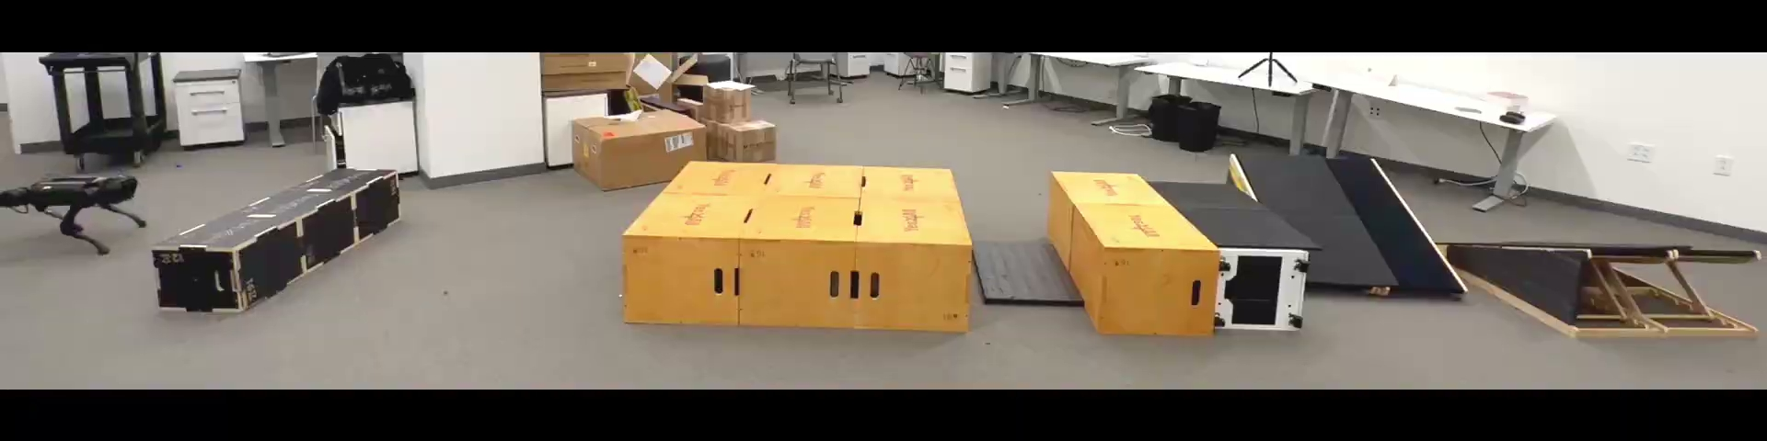
Quadrupeds: balance through changing contacts
The base moves. Ground contact changes at every step.
Extreme Parkour · Cheng et al., ICRA 2024 · real robot
A ROBOTICS OVERVIEW / 4 OF 51
Notes:
2–3 min (1 min).
Now release the base from its mount. This quadruped learns parkour with large-scale RL in simulation and uses a front-facing depth camera. The clip shows a physical robot crossing an obstacle course. Four legs provide more possible support contacts, but fast locomotion is still a dynamic balance problem and can include flight phases. Do not equate four legs with guaranteed stability. Source: https://extreme-parkour.github.io/

Slide 5
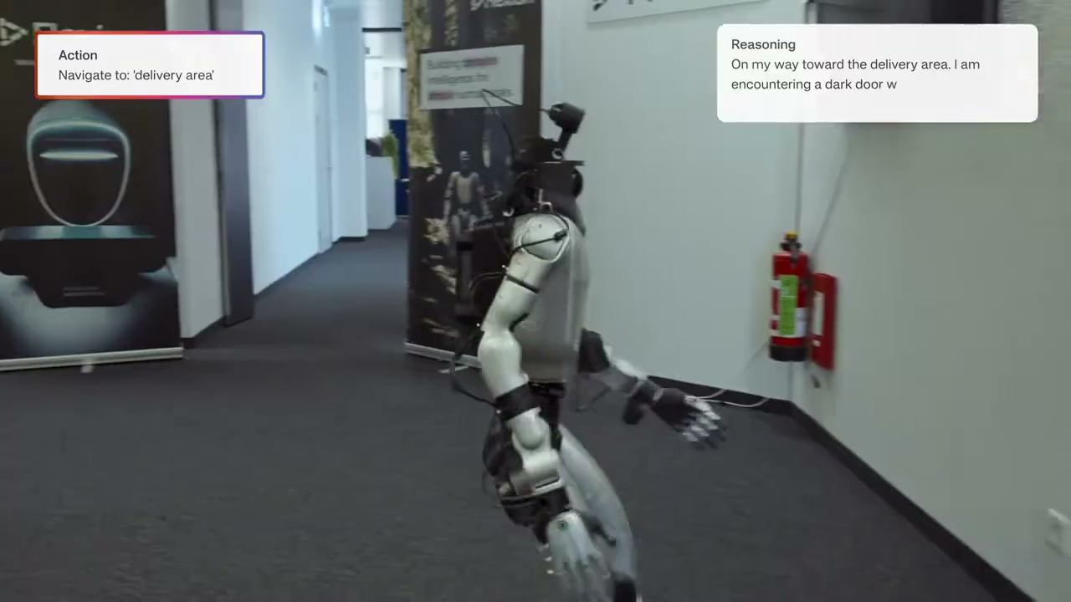
Humanoids: move, manipulate, and balance
Flexion · Reflect · stairs and box pickup · demo excerpts
A ROBOTICS OVERVIEW / 5 OF 51
Notes:
3–4 min (1 min).
Flexion demonstrates a humanoid navigating a building and manipulating objects. Explain the added coupling: moving the arms or carrying an object changes what the legs and torso must do to keep balance. With fewer available support contacts, whole-body coordination becomes central. Flexion describes mission-level VLM reasoning, a motion layer combining a VLA with RL-based skills, and a real-time whole-body controller. The demo illustrates an integrated system, not one monolithic policy or a WAM. Source: https://flexion.ai/news/flexion-reflect-v1.0

Slide 6
VLA and WAM: reuse pretrained models
VLA · Vision–Language–Action
WAM · World–Action Model
Pretrained
vision-language model
Pretrained
video model
Adapt with robot data
Adapt with robot data
Predict robot actions
Predict video + actions
This course: learn motion control from demonstrations and RL.
Examples: RT-2 (VLA) · DreamZero (WAM)
MODELS AND CONTROL / 6 OF 51
Notes:
4–5 min (1 min).
This diagram shows training, not a runtime chain of modules. Visual observations going into actions do not by themselves make a policy a VLA or WAM. RT-2 adapts a pretrained vision-language model to output robot actions, retaining image/text knowledge. DreamZero builds on a pretrained video diffusion model and learns to jointly predict future video and actions. Its video prior supplies learned regularities about how scenes change, not a physics guarantee. These are representative approaches, not an exhaustive taxonomy: not every VLA or WAM must use these exact backbones, and the families can overlap. Both can run closed-loop using observations and instructions; proprioception is omitted here. Our course focuses on learning a feedback motion controller using motion demonstrations and RL rather than adapting a vision-language or video backbone. Sources: https://robotics-transformer2.github.io/ ; https://dreamzero0.github.io/

Slide 7
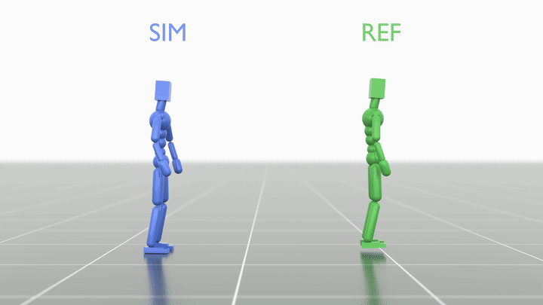
Our focus: teach a biped to move
Start with human
motion capture.
Adapt it to the robot.
Learn control with RL.
Human data shows how to move. RL learns how to stay in control.
Motion tracking: a reference motion guides a feedback controller.
OUR COURSE / 7 OF 51
Notes:
5–6 min (1 min).
Transition from the overview to the course. A biped can fall and needs active balance during motion. Human motion capture supplies useful examples of coordinated behavior, not robot motor commands. We adapt the reference to the robot and learn a feedback policy that executes it under physics. Across diverse motions, this can form the basis for a reusable motion prior and later task learning. We start by distinguishing a kinematic motion from physical control on the next slide. This course focuses on that control foundation rather than training an entire VLA or WAM. The animation is the same motion-tracking visual used later in the lecture. Source: https://github.com/tesslerc/nvidia-mentee-rl-robotics-course

Slide 8
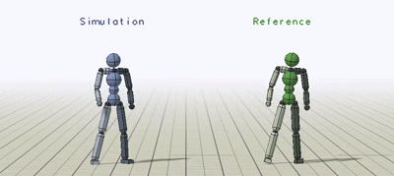
Animation: poses versus actions
Controlled motion
Kinematic motion
A proposed motion
Describes how the
body could move.
A feedback policy
State → actions
Physics determines
the resulting motion.
DeepMimic · Peng et al., SIGGRAPH 2018
FROM ANIMATION TO ROBOTICS / 8 OF 51
Notes:
6–8 min (2 min).
Animation describes a body changing pose over time. In kinematic playback, the pose sequence is applied directly, without requiring actuator forces to generate it. The green DeepMimic reference is this playback. In physics-based animation, the blue character is moved by actions selected by a feedback policy, and the simulator computes the resulting motion. A motion plan or a generator can propose a future pose sequence; a controller makes it happen and reacts to the state it actually reaches. This is a planning/control analogy, not a claim that a fixed clip is a learned world model. A world model predicts consequences, a planner chooses a desired future, and a controller chooses actions. DeepMimic combines reference-motion imitation with reinforcement learning for high-quality physics-based movement. The paired flip visual demonstrates reproduction in simulation; it does not itself demonstrate perturbation recovery. Sources: https://xbpeng.github.io/projects/DeepMimic/index.html and https://bair.berkeley.edu/blog/2018/04/10/virtual-stuntman/ . GIF: authors' sideflip comparison, blue simulation on the left, green kinematic reference on the right.

Slide 9
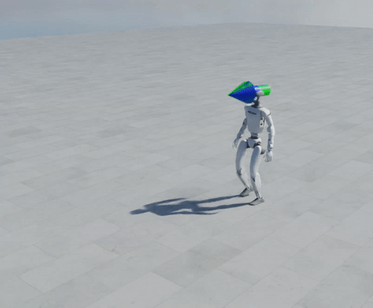
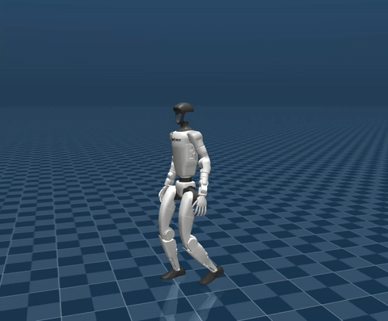
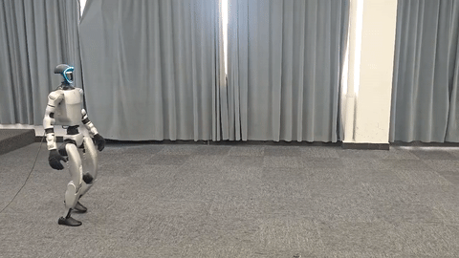
Simulation is a means to an end
IsaacLab
MuJoCo
Real robot
FROM ANIMATION TO ROBOTICS / 9 OF 51
Notes:
8–9 min (1 min).
The previous slide showed that animation itself can be physics-based and reactive. Robotics adds a different end goal: the controller must operate a physical machine. We use simulation to learn, test, and deliberately explore failures before deployment. A simulator approximates reality; success there is not a guarantee of real-world success. Point to the IsaacLab, MuJoCo, and hardware panels as examples of the path from training to deployment, not as identical trials or evidence for this course's checkpoints. Real robots introduce sensing, actuator limits, latency, contact uncertainty, and safety constraints. This motivates the control-interface and transfer sections that follow. GIFs: Unitree RL Lab public demonstrations.

Slide 10
Three questions
01
02
03
What does the policy
actually control?
How do we teach it
to move?
Why does it fail
outside training?
INTRODUCTION / 10 OF 51
Notes:
9–10 min (1 min).
Roadmap: from animation to physical robots, then interfaces and task choices; motion tracking as a foundation; data coverage, transfer, and scenes; closing demonstrations of prompting and adaptation. Focus on robotics design choices, not a repeat of PPO derivations.

Slide 11
A policy is one part of the control loop
Goal / reference
Observation
Policy
Actions
Robot
“Simulator”
Sensor feedback
Our target “simulator” is the real world.
THE PHYSICAL INTERFACE / 11 OF 51
Notes:
10–13 min (3 min).
Walk once around the loop: sensors and state estimation produce observations, policy produces joint targets, a low-level controller produces actuator commands, the physical robot moves, sensors measure the result. Desired motion or task commands are additional inputs. Reward and critic are training components, not runtime inputs. Ask where latency enters.

Slide 12
Fixed base vs. floating base
Fixed-base arm
Floating-base robot
Base position and orientation are fixed.
Base can move and rotate in the world.
Base (pelvis)
3 position +
3 orientation DOFs
Bolted to the ground
Joint motors move the arm.
The mount holds the base fixed.
Joint motors move the limbs.
Contacts help move and balance the body.
“Floating” means not fixed to the world, not hovering.
THE PHYSICAL INTERFACE / 12 OF 51
Notes:
13–15 min (2 min).
The base is the body frame used as the root of the kinematic model. A fixed-base arm is rigidly attached to the world: its joints move, but the mount's position and orientation do not. For a humanoid, we commonly choose the pelvis as the floating base. It has six unactuated degrees of freedom: three translations and three rotations. These are state variables, not six extra motor commands. Joint torques act through the coupled body dynamics and contacts to move and balance the robot. A foot touching the floor does not make this a fixed-base system: contacts can change, slip, or break. “Floating” does not mean airborne. Bridge to the next slide: contact changes which motions and forces are possible.

Slide 13
Contact changes what motion is possible
WITHOUT CONTACT
No ground force
WITH CONTACT
Ground exerts force
THE PHYSICAL INTERFACE / 13 OF 51
Notes:
15–18 min (3 min).
Contrast standing support, swing, and landing. A planted foot can exert a contact force, a swing foot cannot. Friction limits tangential forces; a rigid contact model is an approximation. Do not suggest that center of mass must always stay inside a static support polygon during dynamic motion. Ask: can a walking animation be physically infeasible?

Slide 14
What the robot senses vs. what simulation knows
PROPRIOCEPTION
PRIVILEGED INFORMATION
Sensing the robot’s own body
Encoders: joint angles
IMU: rotation rate and acceleration
Tilt and joint speeds are estimated
Training-only information that is
unavailable to the deployed policy
Examples: exact body velocity,
contact forces, ground friction
We typically train with asymmetric actor-critic observations
THE PHYSICAL INTERFACE / 14 OF 51
Notes:
18–20 min (2 min).
Proprioception means sensing the robot's own body. Joint encoders measure angles. A torso IMU measures angular velocity and specific force (accelerometer output). Filtering and state estimation provide quantities such as tilt and joint speeds. Previous actions are known controller history, not sensor measurements. Exteroception, such as cameras or depth sensors, provides information about the surrounding world. Privileged information is defined relative to the deployed policy's input interface: it is available during training but not supplied to that policy at deployment. Examples include simulator ground-truth base velocity, contact forces, and friction parameters. Some quantities can be estimated or measured with additional hardware; this does not make their exact simulator values deployable. Privileged information can improve rewards, a critic, or a teacher, while the deployed policy uses only its chosen sensors and estimates. Later slides explain teacher–student training.

Slide 15
What can a policy action map to?
Three common interfaces to the same physical robot
Position target
Velocity target
Torque command
PD controller
Velocity controller
Torque / current loop
All produce motor torque. The interface changes what RL must learn.
THE PHYSICAL INTERFACE / 15 OF 51
Notes:
20–22 min (2 min).
The policy can output desired joint positions, desired joint velocities, or torque commands. Position targets use a position servo, often PD. Velocity targets use a velocity servo. Direct torque commands still pass through torque/current regulation and actuator limits. These are alternative action interfaces, not three sequential stages. Gains, action scaling, latency, saturation, and the actuator model all affect the learning problem. The course uses position targets. Avoid suggesting that choosing PD prescribes a gait.

Slide 16
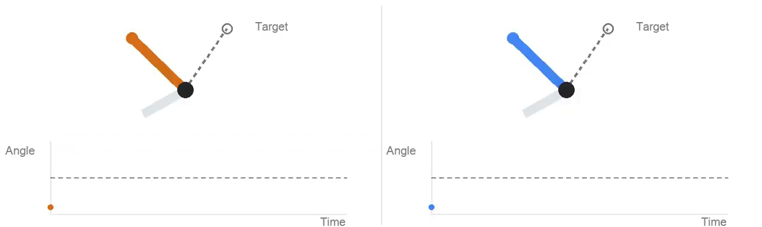
PD control: a virtual spring and damper
P only: a virtual spring
P + D: spring and damper
τ = Kp (q_target − q) − Kd q̇
D opposes velocity, like friction. Both terms act together.
PD CONTROL · ILLUSTRATIVE JOINT / 16 OF 51
Notes:
22–24 min (2 min).
Use the 7-second animation to predict and then compare the response. Both joints have identical unit inertia, initial angle, target, and proportional gain. The left uses proportional control only; the right adds damping. Torque tau is Kp times the position error minus Kd times measured angular velocity. Desired angular velocity is zero here; for a moving target, derivative feedback can use desired minus measured velocity. The simplified model has no gravity, passive damping, torque limits, or contact. Kp=12, Kd=0 versus 7, inertia=1; explicit integration at 1 ms. P-only oscillation here is illustrative, not a claim that all physical P-only systems oscillate forever. Too much or too little damping changes settling, and latency or large gains can cause problems. The policy chooses the target; PD handles local feedback.
Explain the physical intuition: P acts like a virtual spring pulling toward the target. With zero desired velocity, D acts like viscous friction, applying motor torque opposite to joint velocity and reducing oscillation. This is active damping produced by the motor, not passive mechanical friction. Both terms act simultaneously, not in two sequential phases.

Slide 17
PD targets can make learning easier
Example: a simulated planar raptor learns to run
Normalized area under the learning curve (higher is better)
Torque
0.38
Velocity target
0.70
PD position target
0.84
Muscle activation
0.73
0
1
PD had the highest learning AUC on 5 of the 7 tested motions.
Peng & van de Panne, SCA 2017 · Table 4 · planar imitation tasks, not G1 results
THE PHYSICAL INTERFACE / 17 OF 51
Notes:
24–26 min (2 min).
Source: Xue Bin Peng and Michiel van de Panne, Learning Locomotion Skills Using DeepRL: Does the Choice of Action Space Matter?, SCA 2017, supplemental Table 4. https://xbpeng.github.io/projects/ActionSpace/index.html The chart reproduces the Raptor Run row, not Run (Sim): torque 0.3814, velocity 0.7008, PD 0.8372, muscle activation 0.7258. AUC is normalized area under the learning curve, a summary of progress over training; it is not success rate, final return, or wall-clock time. Four actuation models are shown to preserve the study's comparison. PD has the highest AUC in five of seven tasks; it is not universally best. The study uses planar imitation tasks, not G1 hardware. Explain that local feedback is a useful inductive bias: the learner can specify targets instead of discovering every stabilizing torque from scratch.

Slide 18
Physics and PD run faster than the policy
G1 example: Unitree’s MuJoCo deployment. Rates vary by setup.
Hold target A
Hold target B
RL policy
50 Hz · every 20 ms
0 ms
20 ms
40 ms
10 PD + physics steps per policy update
PD feedback
500 Hz · every 2 ms
Physics steps
500 Hz · every 2 ms
The target is held. PD keeps updating torque from fresh joint feedback.
Sources: Unitree G1 MuJoCo config + control loop
Hardware example: HUSKY (50 Hz policy / 500 Hz PD)
THE PHYSICAL INTERFACE / 18 OF 51
Notes:
26–29 min (3 min).
Concrete example, not a universal G1 specification. Unitree's official unitree_rl_gym G1 MuJoCo configuration sets simulation_dt=0.002 seconds and control_decimation=10. The simulation loop recomputes PD torque from current q and qdot every physics step, then advances MuJoCo. It runs policy inference every tenth step. Thus PD/physics run at 500 Hz and the policy at 50 Hz (20 ms). Between inference steps, the desired joint angles stay fixed, but the torque changes as the robot moves. The two dense timeline rows represent successive operations in the same inner loop, not a claim that they occur simultaneously.
Sources:
https://github.com/unitreerobotics/unitree_rl_gym/blob/main/deploy/deploy_mujoco/configs/g1.yaml
https://github.com/unitreerobotics/unitree_rl_gym/blob/main/deploy/deploy_mujoco/deploy_mujoco.py
HUSKY, Section IV-A, reports a real G1 at 50 Hz policy with 500 Hz joint PD: https://arxiv.org/html/2602.03205v1#S4.SS1
Rates vary. BeyondMimic's public training config uses simulation dt=0.005 and decimation=4 (200 Hz physics, 50 Hz policy): https://github.com/HybridRobotics/whole_body_tracking/blob/main/source/whole_body_tracking/whole_body_tracking/tasks/tracking/tracking_env_cfg.py
SONIC reports 50 Hz inference and a 500 Hz target publishing process. A command publishing frequency should not be automatically identified with the internal motor servo frequency: https://nvlabs.github.io/GEAR-SONIC/static/pdf/sonic_paper.pdf
On real hardware, physics evolves continuously; it does not have a numerical simulation tick. Do not claim that all G1 controllers run PD at 1 kHz. The simplified hierarchy analogy concerns separation of timescales and target abstraction: the low-level PD law is fixed, not a learned subpolicy.

Slide 19
What can we train a robot to do?
Locomotion
Manipulation
Follow speed and heading commands
Grasp, insert, or place objects
Recovery
Motion tracking
Return to standing after a fall
Follow a reference body motion
Our entry point: motion tracking.
LEARNING MOTION / 19 OF 51
Notes:
29–30 min (1 min).
These are examples of objectives built around the same observation-action-physics loop. Locomotion follows commands, manipulation moves an object, recovery returns to standing, and motion tracking follows a reference. They overlap: a tracking policy may execute walking, reaching, or a get-up. Motion tracking is the entry task for this course because a reference gives a concrete objective and abundant motion data. Entry-level means a structured starting point, not an easy solved problem. Transition to why tracking can provide a foundation beyond reproducing a single clip.

Slide 20
Motion tracking: a gateway from human data
1. HUMAN DATA
2. MOTION TRACKING
3. REUSE AND ADAPT
People provide rich examples of coordinated movement.
Learn to execute those motions with the robot’s body.
Build a motion prior, then optimize for new tasks in simulation.
Learn how to move from demonstrations before learning new tasks.
LEARNING MOTION / 20 OF 51
Notes:
30–31 min (1 min).
The central motivation is data. Generative models benefit from high-quality, diverse examples, and humans provide a rich source of movement demonstrations. Motion tracking is the gateway that makes these demonstrations useful for robot control: after adapting the motion to the robot's body, we train a feedback controller to reproduce it under simulated physics. This already involves optimization in simulation; the distinction is learning to execute demonstrations first, then adapting to new task objectives. Across many motions, tracking can provide a foundation or supervision for a reusable generative motion prior. Tracking alone is not automatically a generative model, and transfer to unseen tasks is not guaranteed. Later examples show two routes: learning task adapters on top of a prior, or supplying new goals to a frozen promptable controller. Human demonstrations are an important data source, not the only one; synthetic data can fill gaps such as recovery states.

Slide 21
Design the interface before training
Make the humanoid follow a walking reference.
1 What can the actor observe?
2 What should one action mean?
3 What changes if the sensors arrive late?
LEARNING MOTION / 21 OF 51
Notes:
31–32 min (1 min).
Invite students to take a minute to think individually about the three questions. No pair discussion or group reporting. Advance to the next slide for a worked answer. The question and answer together retain the original three-minute slot.

Slide 22
One practical design
A feedback policy with PD joint targets.
1 Joint angles/speeds, IMU, history, reference goals.
2 Joint-position targets for a PD controller.
3 Use recent history and train with realistic delays.
LEARNING MOTION / 22 OF 51
Notes:
32–34 min (2 min).
Reveal this after the one-minute individual reflection. Present it as one practical design, not the only correct answer.
1. Joint angles and speeds and inertial measurements describe the current body motion. Recent observations and previous actions provide context. Reference goals tell the policy which motion to follow. Keep privileged simulator-only state separate from deployable actor inputs.
2. Map the policy outputs to joint-position targets for a faster PD controller. Velocity targets and direct torque are other valid designs, as discussed earlier.
3. Delayed measurements describe an earlier state. Use recent observation/action history and train with delays representative of deployment. History can help infer current motion but does not remove latency or guarantee stability.
The reference supplies the desired motion. Feedback lets the policy adjust its actions as the actual state changes.

Slide 23
A motion clip is a goal, not a controller
Motion clip
Retargeting
Robot reference
Tracking policy
Describe the motion
Find actions that realize it
Kinematic compatibility does not guarantee physical feasibility.
LEARNING MOTION / 23 OF 51
Notes:
34–37 min (3 min).
Retargeting maps a reference motion to another body while accounting for geometry and joint limits. That kinematic fit does not prove the motion is dynamically feasible. Tracking then learns actions that realize the motion under physics. Distinguish direct state playback from an actual feedback controller.

Slide 24
Motion tracking: turn pose error into reward
An L2-style objective,
used as an RL reward.
error = ‖p − p*‖²
reward = exp(−k · error)
p: body positions p*: reference
Smaller error → higher reward
RL learns actions that reproduce the motion through physics.
LEARNING MOTION / 24 OF 51
Notes:
37–40 min (3 min).
The animation compares a simulated character (SIM, blue) with its kinematic reference (REF, green). Reference: supplied GPC presentation, slide 13. This is an illustrative tracking example, not a G1 hardware recording.
Connect this to a reconstruction objective: compare the simulated body positions p with reference body positions p* at the same motion time in a common coordinate frame. The squared Euclidean (L2) error is a simple example of a tracking error. k is a positive sensitivity parameter. Converting it to exp(-k*error) gives a higher reward for smaller errors. Equivalently, one can penalize squared error; actual tracking rewards often combine separate position, rotation, and velocity terms. The next slide explains these additions.
This displayed formula is pedagogical, not a claim about the exact GPC reward. We are not supervising actions with an L2 action loss and not directly assigning reference poses to the simulated character. The policy observes the current state and reference, outputs actions, and the simulator determines the next state. RL optimizes accumulated reward through interaction, without requiring a differentiable simulator. Gravity, inertia, contacts, and actuator limits still apply.
Unlike a fixed sequence of copied poses, a tracking controller can choose different actions after a disturbance to return toward the same reference.

Slide 25
Reward the behavior you actually want
MATCH MOTION
CONTROL QUALITY
RESPECT LIMITS
Body poses
and velocities
Avoid abrupt
action changes
Penalize motion near
joint limits
In robotics, good regularization is key to success
LEARNING MOTION / 25 OF 51
Notes:
40–43 min (3 min).
A tracking objective typically combines pose and velocity agreement with control-quality and joint-limit penalties. Discuss how an oversized smoothness reward can favor standing still, and why tracking accuracy alone does not guarantee useful actions. Reward penalties are not hard safety guarantees.

Slide 26
Resets decide which states are learned
Sample a point
in the motion
Initialize the
robot state
Act and
observe
Continue
or reset
Recovery depends on the states and outcomes covered during training.
LEARNING MOTION / 26 OF 51
Notes:
43–46 min (3 min).
Reference-state initialization exposes later portions of a motion without first solving its beginning. Failure termination can improve training efficiency but remove the experience needed to recover. Reset noise and perturbations broaden state coverage. Distinguish regaining balance from getting up after a fall. Neither follows automatically from choosing PPO.

Slide 27
Train with more information than you deploy
Robot observations
Actor
Actions
Simulator state
Critic
Training only
LEARNING MOTION / 27 OF 51
Notes:
46–48 min (2 min).
The actor uses observations available at deployment. The critic can use additional simulator state during training to estimate value. The critic is not needed at runtime. Distilling a privileged teacher into a deployable student is a different route, illustrated later by ADEPT.

Slide 28
A trained controller can become a teacher
SO FAR: LEARN BY RL
NEXT: LEARN FROM ACTIONS
Track human motion
using rewards in simulation.
Use the tracker’s actions
to train a student policy.
FROM TRACKING TO IMITATION / 28 OF 51
Notes:
48–48.5 min (0.5 min).
We have trained a tracker with RL to execute motion demonstrations. We can now use it as an expert that supplies actions for training another policy. This is useful when changing the architecture, inputs, or goal interface, or building a reusable motion prior. This step is optional: a tracker can also be deployed directly. The next question is whether recording expert rollouts and fitting the actions is enough. This motivates behavior cloning and the distribution-shift problem.

Slide 29
Can we just copy the trained controller?
Run expert
Record
observations + actions
Fit student
Roll out student
Matching actions in a dataset is not the same as succeeding in a rollout.
BEHAVIOR CLONING / 29 OF 51
Notes:
48.5–50.5 min (2 min).
Collect observation-action pairs from a competent controller, fit a student by supervised learning, then run it closed-loop. Match observation and action conventions. Low held-out action error does not establish long-horizon control quality. This basic imitation idea also appears inside larger distillation pipelines.

Slide 30
Why naive behavior cloning can fail
Demonstrated states
After an imitation error
state
state
state
state
state
Unfamiliar states → larger errors → further drift
BEHAVIOR CLONING / 30 OF 51
Notes:
50.5–53.5 min (3 min).
Naive behavior cloning fits the expert's actions on a fixed dataset of expert-visited states. During deployment, even a small imitation error changes the next state. The student can then encounter observations missing from its training data, make a larger error, and drift further. No external push is required. The diagram is illustrative, not measured data. Low held-out action error on expert states therefore does not guarantee successful closed-loop behavior. This is a distribution-shift problem, not a claim that BC always fails. Transition: rather than collecting only successful expert motion, teach corrective actions at states the learner is likely to encounter. Source: Ross, Gordon, and Bagnell, AISTATS 2011, https://proceedings.mlr.press/v15/ross11a.html

Slide 31
Teach the policy how to correct its mistakes
DAgger: STUDENT-DRIVEN
NOISY EXPERT COLLECTION
Roll out the student.
Ask the expert for actions.
Add labels to the dataset.
Retrain and repeat.
Perturb expert actions.
Record clean expert targets
at the states reached.
Train BC on this dataset.
BEHAVIOR CLONING / 31 OF 51
Notes:
53.5–55.5 min (2 min).
Two alternative ways to collect corrective supervision. DAgger (Dataset Aggregation): roll out the current student, query a capable expert for the appropriate action at each visited state, aggregate those labeled samples with earlier data, train the student, and repeat. Early rollouts may mix expert and student actions. Noisy-expert collection: execute expert actions with added noise or perturbations so the expert visits off-nominal states. Store the expert's clean intended action at the actual visited state, not the noise-corrupted action that was executed. Train BC on this expanded dataset. This creates recovery examples without rolling out the current student, but its usefulness depends on the perturbations covering the learner's likely errors and the expert being able to correct them. DART is a related method that tunes noise to approximate learner error; arbitrary noise injection is not the full DART algorithm. Neither method guarantees recovery outside the collected coverage. Sources: Ross et al. (2011), https://proceedings.mlr.press/v15/ross11a.html ; Laskey et al. (2017), DART, https://arxiv.org/abs/1703.09327

Slide 32
What if the world changes too?
SO FAR: DIFFERENT STATES
NEXT: DIFFERENT PHYSICS
DAgger and noisy experts
teach corrections where
the student may drift.
Friction, mass, and delays
may differ from training.
FROM IMITATION TO TRANSFER / 32 OF 51
Notes:
55.5–56 min (0.5 min).
The previous section addressed which states we train on: a student may drift away from expert demonstrations. Now change the question. Even if it handles those states in the training simulator, what happens when friction, mass, motor response, or delay changes? DAgger does not by itself fix an inaccurate physics model. Domain randomization exposes training to a range of plausible conditions, while sim-to-sim checks behavior in another engine. These are complementary tools; changing dynamics also changes the states encountered. A useful transition line: we have broadened the states, and now we broaden the worlds.

Slide 33
The real world is not one fixed setting
Same weights
One training setting
Real-world variation
A fixed floor, robot model, and timing
Sand, rubber, wood; changing temperature
Handle both imperfect models and changing real-world conditions.
SIM-TO-REAL / 33 OF 51
Notes:
56–58 min (2 min).
A policy can succeed in the simulator's nominal physics setting yet fail on hardware because the model is imperfect. Real conditions also vary over time and place: sand can deform, rubber and wood change contact behavior, and temperature can change motor response or limits. The two robot renders are schematic, not a comparison of measured hardware results. The same commands and policy weights can therefore produce different motion. This motivates training over plausible physical variation, rather than assuming one perfectly matched world. Randomizing friction alone does not capture every terrain effect, especially deformable ground such as sand. More representative contact models or targeted data may be needed. We are now motivating domain randomization, not debugging a simulator interface.

Slide 34
Domain randomization: vary the world
Friction
Body dynamics
Sensing / action noise
Resets / pushes
SIM-TO-REAL / 34 OF 51
Notes:
58–60 min (2 min).
Randomize plausible uncertainty in friction, body dynamics, sensing, actions, and disturbances. Distinguish parameters that persist for an episode from per-step noise. Excessively wide ranges can impede learning. Choose ranges from system knowledge and observed failure modes, and keep held-out evaluation conditions.

Slide 35
Sim-to-sim helps, but deployment needs more
1. TEST TRANSFER
2. CHECK THE MODEL
3. BUILD THE SYSTEM
Run the same policy in another simulator to expose simulator-specific behavior.
Validate geometry, mass, motor response, and delays against the real robot.
Integrate real-time control, state estimation, perception, and safety systems.
Two simulators can agree and still share an unrealistic robot model.
SIM-TO-REAL / 35 OF 51
Notes:
60–62 min (2 min).
Sim-to-sim is useful evidence: running a policy in a second physics engine can reveal dependence on the training simulator or errors in the control interface. It is not a direct measurement of hardware performance. Both simulators may share the same inaccurate robot asset, so validate relevant geometry, mass and inertia, motor response, contact behavior, and delays against the physical robot. Visual resemblance alone is not enough. Hardware deployment also requires software and hardware integration: reliable sensor and motor communication, state estimation, perception when the task needs it, and safety systems such as limits, watchdogs, emergency stops, and controlled testing. These steps complement simulation rather than replacing it.

Slide 36
Debug from the interface inward
Bad at reset
Check assets, poses, and frames
Unstable immediately
Check actions, gains, and timing
Fails after a push
Check state coverage and terminations
Fails after transfer
Check conventions, then dynamics
Inspect a rollout and isolate one cause before launching another run.
SIM-TO-REAL / 36 OF 51
Notes:
62–64 min (2 min).
Diagnostic order: invalid motion at reset -> inspect asset, reference, frames, scene alignment. Immediate instability -> actions, PD gains, limits, timing. Good training reward but poor rollout -> rewards, termination, reset and data coverage. Failure only after transfer -> convention mismatches first, then dynamics/observations. Change one factor at a time. This is a practical starting order, not an exhaustive taxonomy.

Slide 37
From theory to practice
ROBOT ARMS
HUMANOIDS
YOUR EXPERIMENTS
AlphaNIST
and ADEPT
RoboGPC
and Metatron
Build and test a
walking controller
FROM THEORY TO PRACTICE / 37 OF 51
Notes:
64–65 min (1 min).
Transition from the general training process to research systems. Ask students to look for the same ingredients in each example: observations, action interfaces, training signals, state coverage, and deployment tests. Start with robot arms, then humanoids, then connect the research back to the course experiments. These are examples, not a ranking of methods.

Slide 38
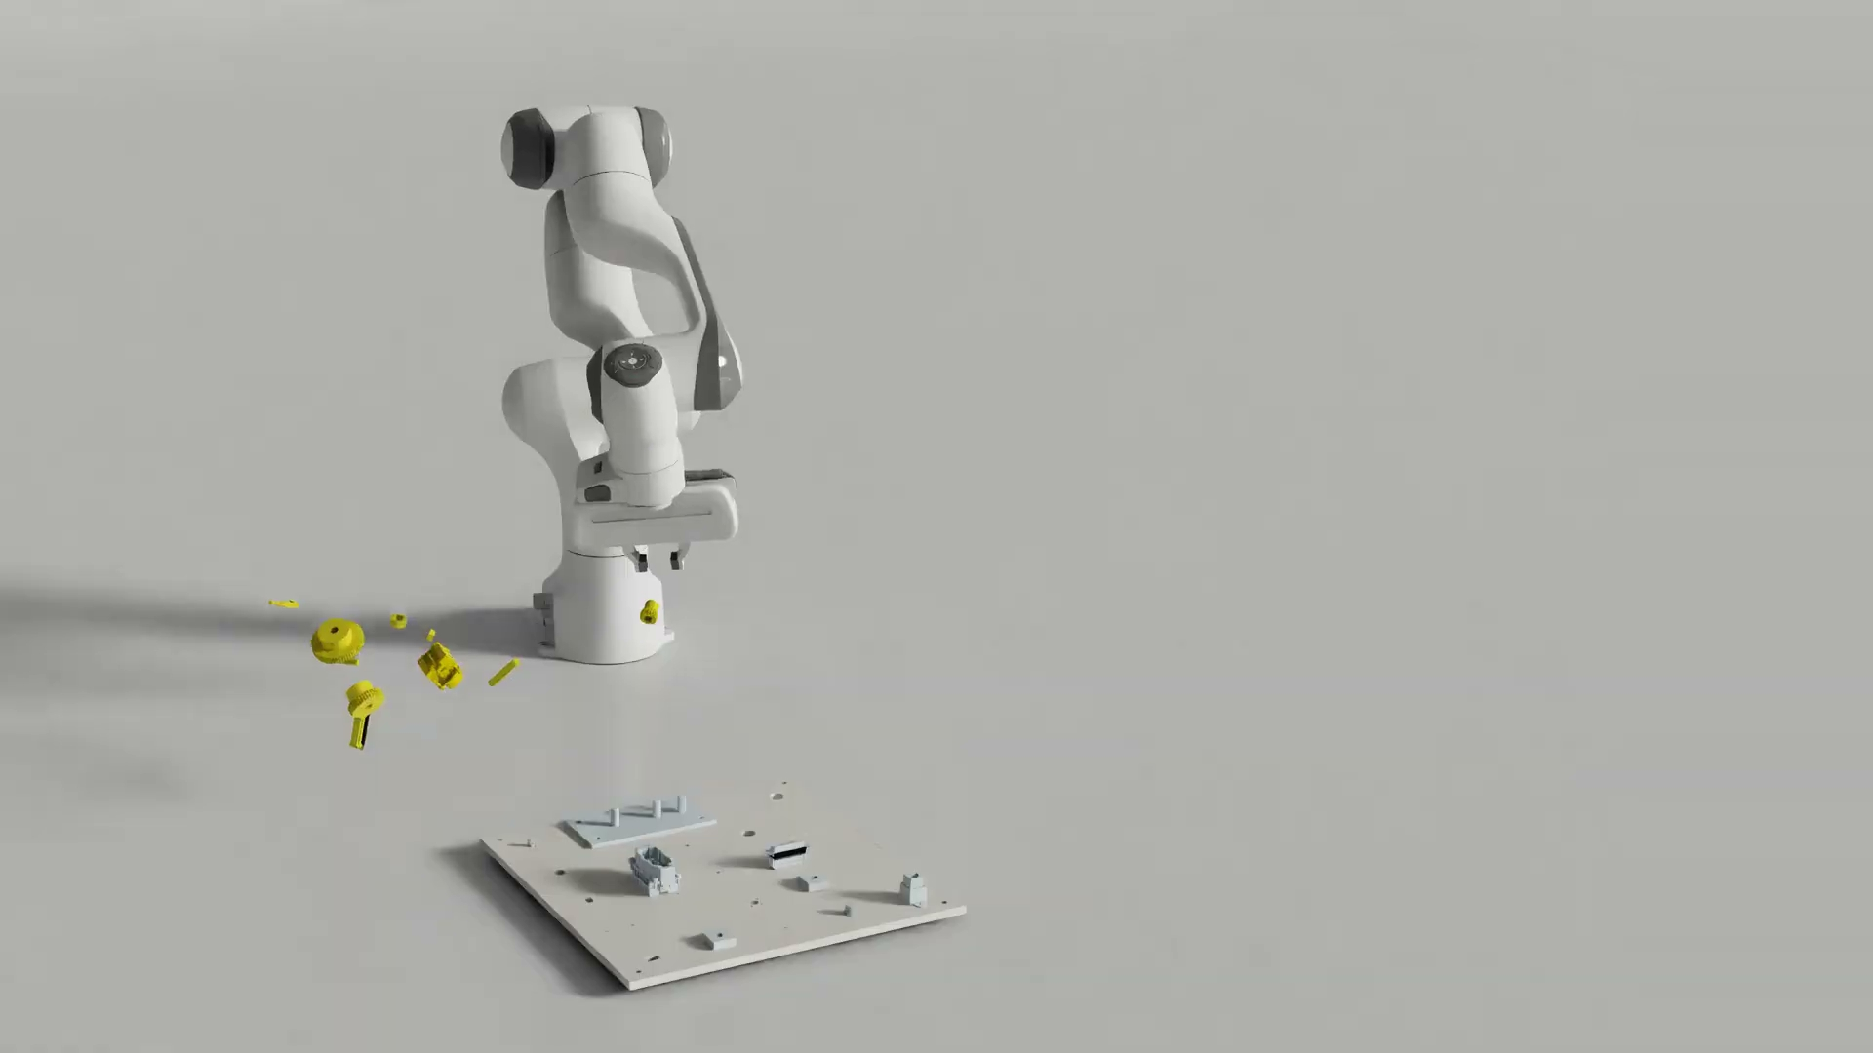
AlphaNIST: learn how to assemble
No demonstrations.
No scripted stages.
Ten parts, one learned sequence.
Ten-part policy · Isaac Lab simulation · Zhang et al., 2026
ROBOT-ARM MANIPULATION / 38 OF 51
Notes:
Show the ten-part assembly example. This is simulation, not a hardware result. The robot learns its manipulation sequence without demonstrations or scripted stages. The ten-part policy is trained separately from the policy that learns all 20 individual assembly tasks.
Source and video: https://alpha-nist.github.io/
Paper: https://arxiv.org/abs/2610.13354

Slide 39
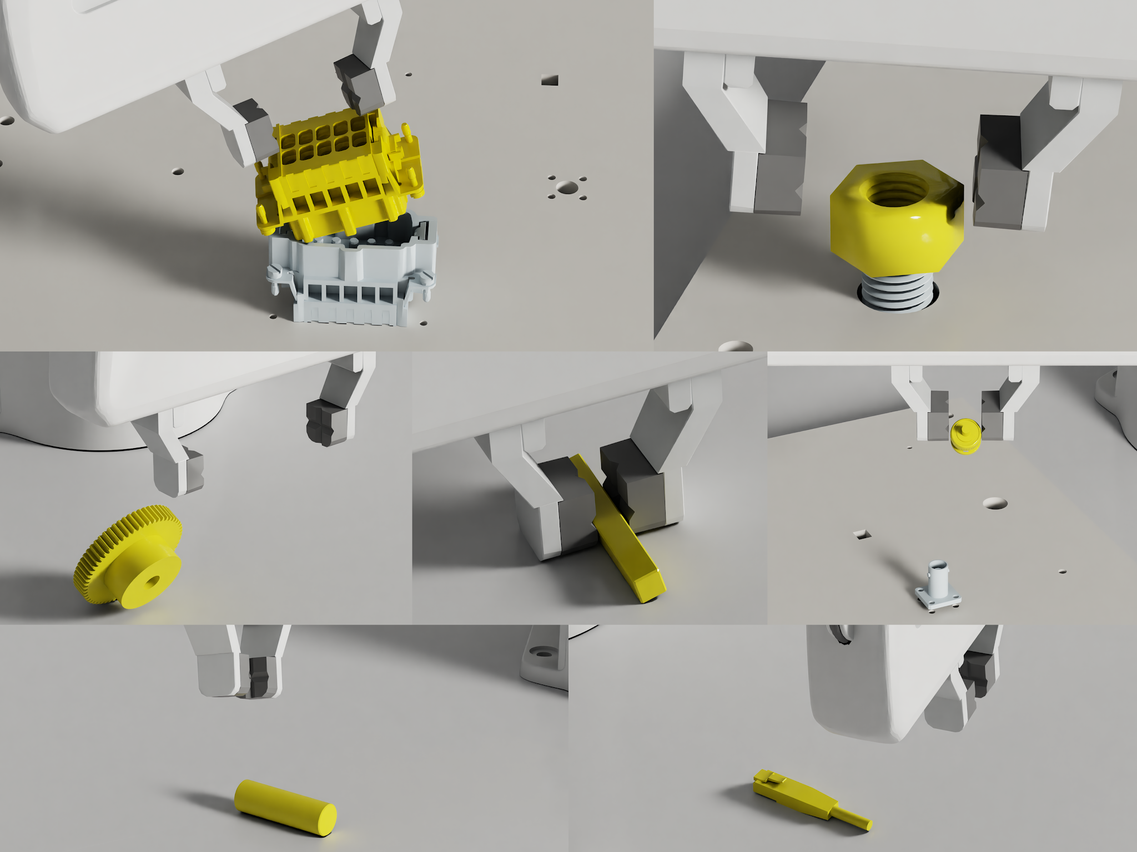
AlphaNIST: make sparse rewards learnable
1 VARIED STARTS
2 PICK PRACTICE
3 TRAIN WITH PPO
Loose, grasped or
partly assembled
Favor starts with
~50% success
Reward success,
not progress
More practice
Completion: 1
0 otherwise
0%
50%
100%
Also penalize
excessive control effort
Recent success rate
Robot state + geometry → policy → joint targets + gripper
Zhang et al., 2026 · NVIDIA and University of Washington · Simulation
ROBOT-ARM MANIPULATION / 39 OF 51
Notes:
One PPO policy learns across 20 individual assembly tasks. Cached reset states span loose parts, grasps and partial assemblies; they provide starting states, not demonstrated action sequences. Success-guided sampling allocates more practice near 50% recent success, while keeping all states sampleable. The task reward marks completed assembly; control penalties discourage excessive effort. Geometry point clouds and robot state feed a policy that outputs joint-position increments and a gripper command at 25 Hz.
The demonstration on the previous slide uses a separately trained ten-part policy. Its task reward requires all active pairs to be assembled together, without a prescribed order.
Source: https://arxiv.org/html/2610.13354v1 (Sections IV-B through IV-D).

Slide 40
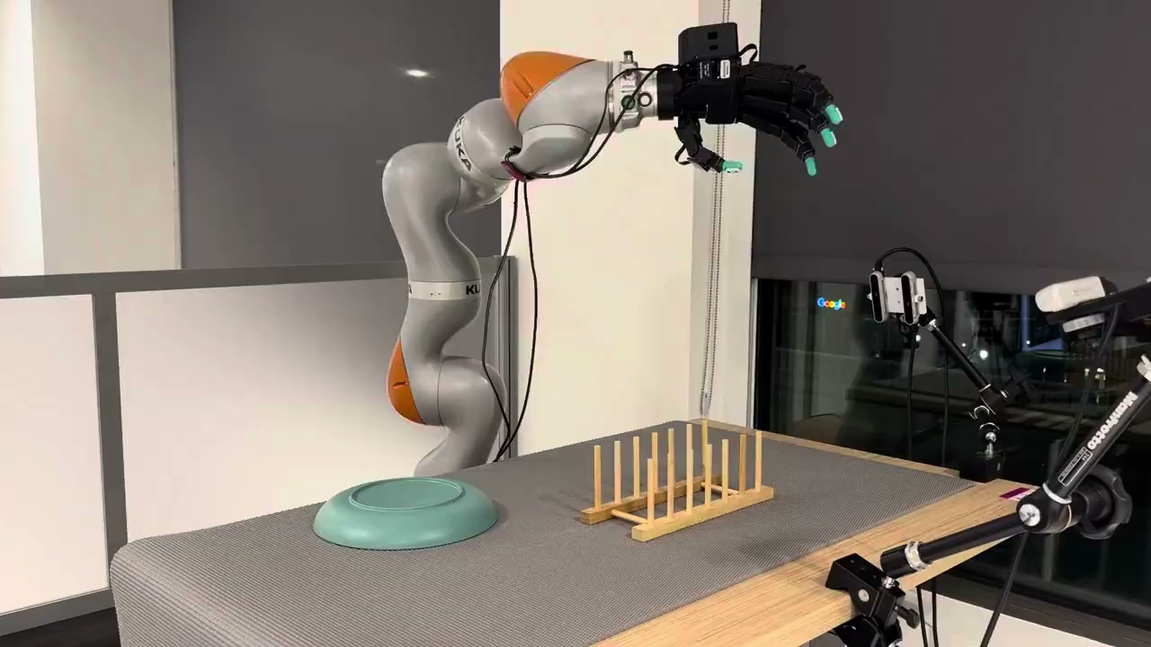
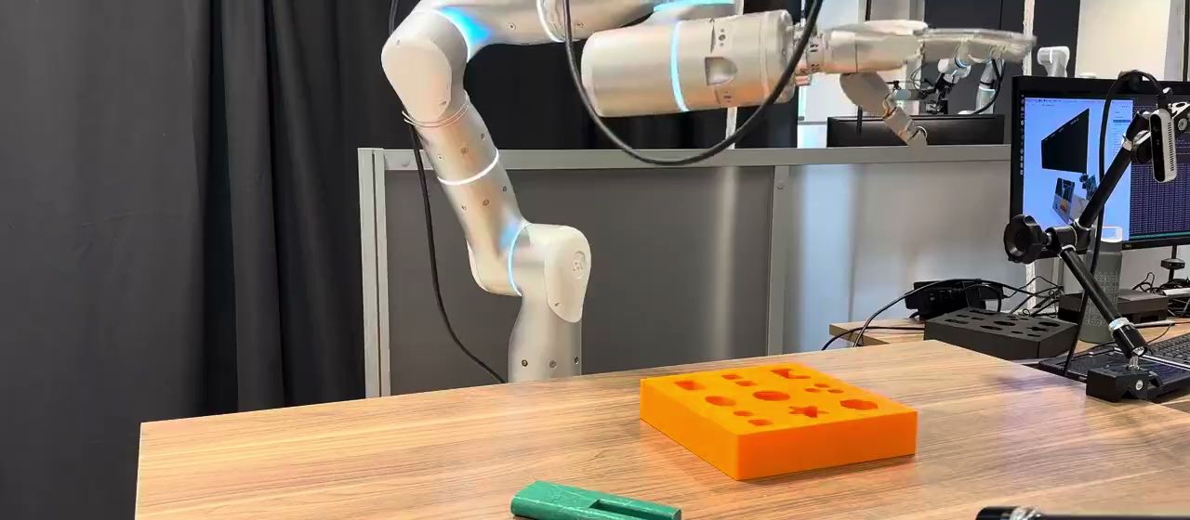
ADEPT: learned dexterity on real robots
Grasp, reorient, insert
Flip, grasp, place
Insertion: 8/10 with vision + touch; 3/10 with vision alone.
Flexiv–Sharpa insertion · 10 trials / condition · Lee et al., CoRL 2026
ROBOT-ARM MANIPULATION / 40 OF 51
Notes:
67–69 min (2 min).
ADEPT, by Lee and colleagues including Ankur Handa, demonstrates insertion and dish placement after simulation training. Left: Flexiv–Sharpa. Right: KUKA–Allegro. The 8/10 versus 3/10 comparison concerns Flexiv–Sharpa insertion with and without tactile input, not the two videos. Ten hardware trials per condition is a limited evaluation, not a universal reliability claim. Connect touch to the earlier question of what the policy can observe. Source: https://adept-dexterity.github.io/

Slide 41
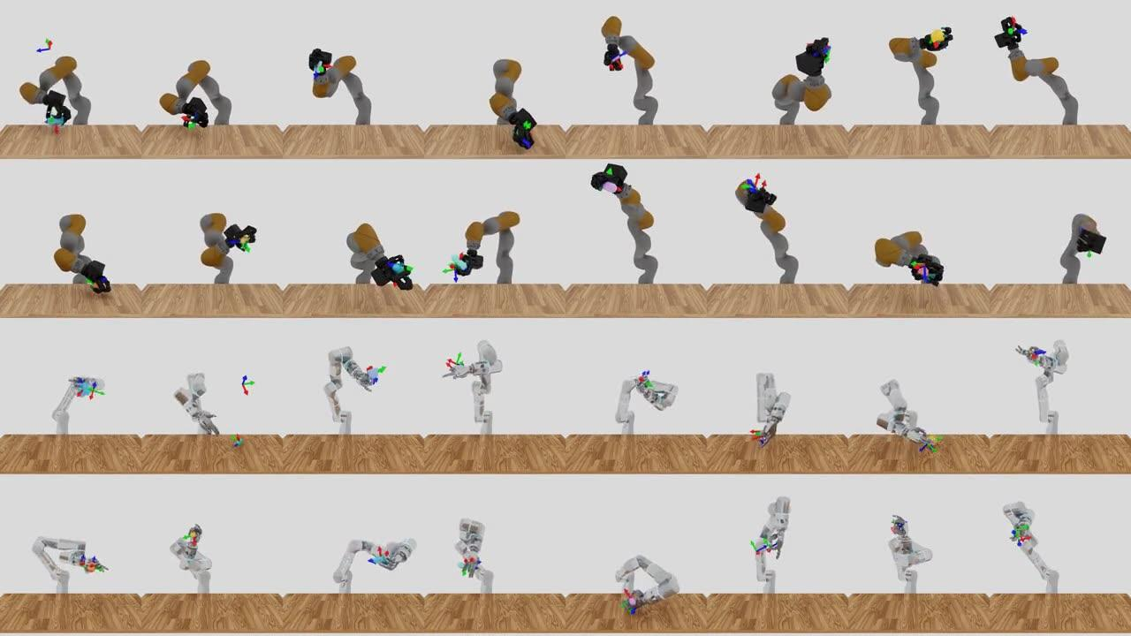
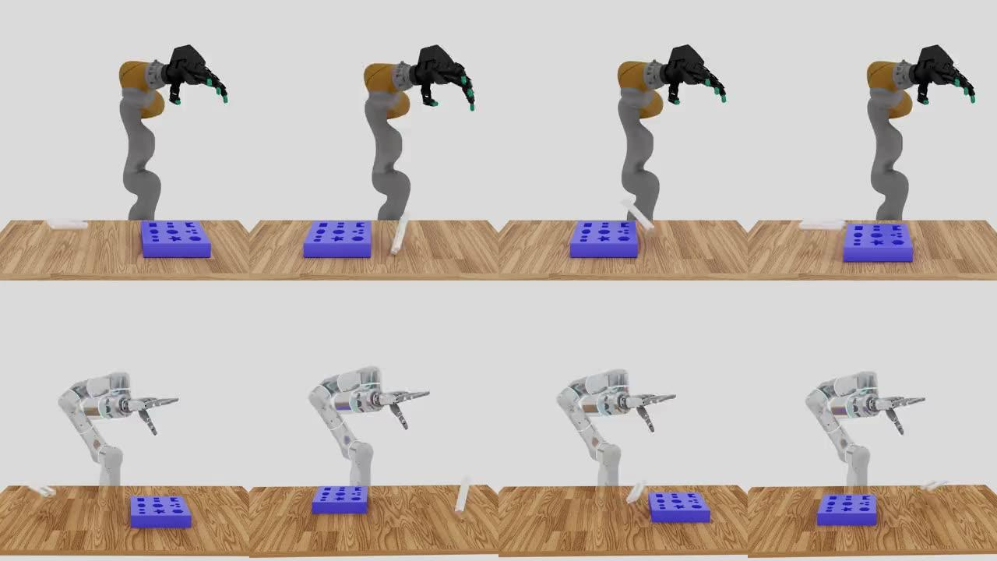
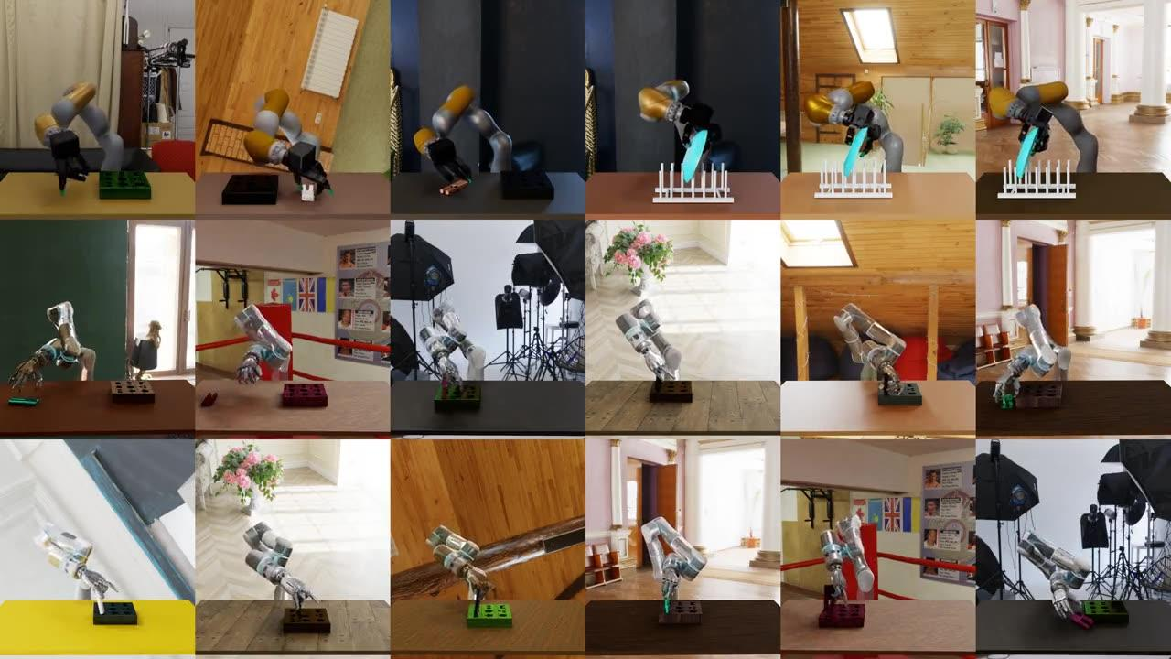
ADEPT: pretrain, adapt, then deploy
1 PRETRAIN
2 ADAPT
3 DISTILL
RL on object
repositioning
Fine-tune for
a specific task
Imitate using
robot sensors
Lee et al., NVIDIA and Michigan
ROBOT-ARM MANIPULATION / 41 OF 51
Notes:
69–72 min (3 min).
First, learn object repositioning on randomized primitive shapes. Second, adapt to task-specific manipulation: transfer the actor by behavior cloning, warm up the new critic, and use conservative PPO updates. Third, distill the specialist into a student using vision and, on the tactile platform, touch. Randomized physics and appearance support transfer. A shared geometric-fabric controller mediates actions in simulation and hardware. The base does not solve every downstream task without training. Connect to reusable priors, privileged teachers, deployable observations, and low-level action interfaces. Source: https://arxiv.org/html/2608.19182v1

Slide 42
From motion tracking to reusable control
Track motions with
discrete skill codes
Predict skill codes
from robot state
Learn lightweight
task adapters
RoboGPC
Train a dense
motion tracker
Distill on-policy
with masked goals
Freeze the policy
Write skill code
Metatron
HUMANOID CONTROL / 42 OF 51
Notes:
72–75 min (3 min).
RoboGPC: train a reference tracker with PPO and a discrete bottleneck. Freeze its encoder/decoder, then train a transformer to predict skill tokens from the current proprioceptive state. Task-conditioned CoLA adapters are trained by supervised learning and/or RL while base weights remain fixed. Domain randomization is used throughout. This is based on the user-supplied local RoboGPC draft; do not add its anonymous website link. Metatron: train a dense tracker with RL, freeze it, and distill its actions on student-visited states while masking future goals. At deployment the learned policy accepts partial goals from skill code, without task-specific policy updates. This row is a high-level teaching summary, not an assertion that the two models share an architecture. Metatron source: https://metatron.lfy.nvidia.com/

Slide 43
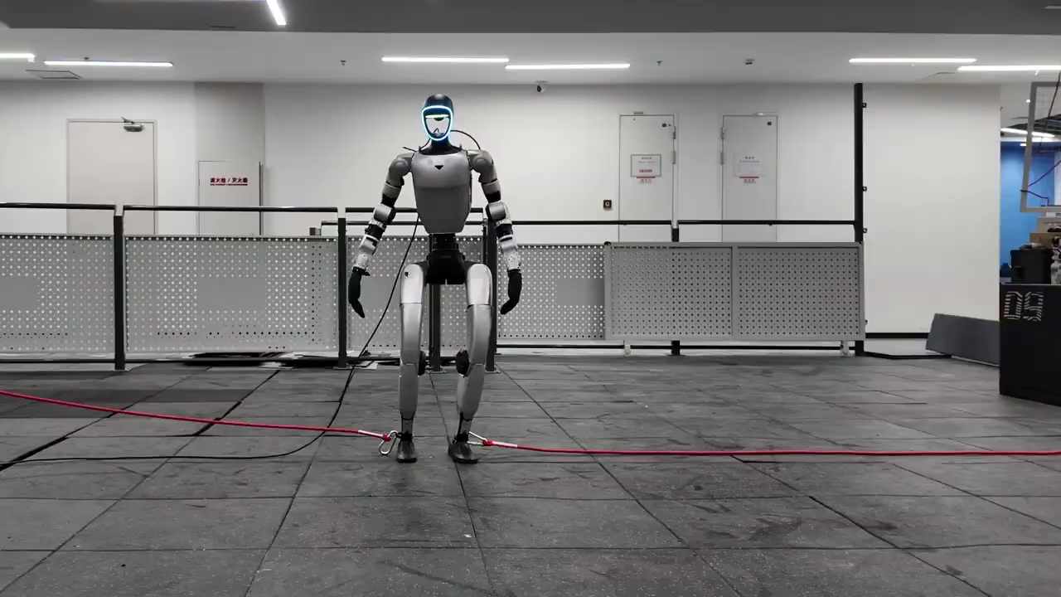

RoboGPC: tracking with feedback
Reference tracking
With external forces
RoboGPC · hardware demonstrations · separate trials
HUMANOID CONTROL / 43 OF 51
Notes:
75–78 min (3 min).
Unpublished RoboGPC material provided by the user. Left: dynamic dance tracking without external perturbations, first 16 seconds. Right: the corresponding behavior with forces applied to the legs, first 20 seconds. These are separate trials, not synchronized measurements or a controlled quantitative comparison. Ask students to identify the reference, measured robot state, and the policy response. Connect back to feedback tracking: the action responds to deviations even when the desired behavior remains the same. A reference-only animation has no mechanism for responding to these forces. Do not infer arbitrary disturbance robustness from this demonstration. Course video copies are in the user-provided shared Drive folder. Do not include the anonymous source website link.

Slide 44
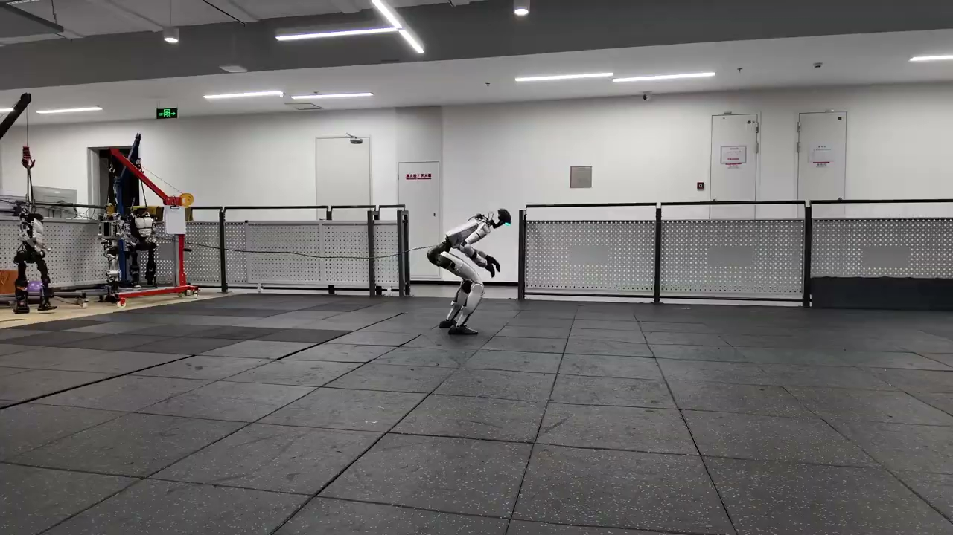
Recovery is part of the control problem
How should it
recover?
Recovery needs
experience beyond
the nominal motion.
RoboGPC · fall and get-up during steering
HUMANOID CONTROL / 44 OF 51
Notes:
78–80 min (2 min).
Unpublished RoboGPC material provided by the user. This excerpt shows a fall and get-up from the squatting-steering demonstration (source seconds 22–41.195). It replaces the cartwheel recovery clip because that clip's Google Slides preview failed. Ask what actions are needed after leaving the nominal behavior. Connect to resets, termination choices, perturbations, and recovery-state coverage. The clip does not establish the cause of the fall or quantify recovery success. It illustrates that evaluating a behavior should include what happens after a failure, not only successful nominal execution. Course video copies are in the user-provided shared Drive folder. Do not include the anonymous source website link.

Slide 45
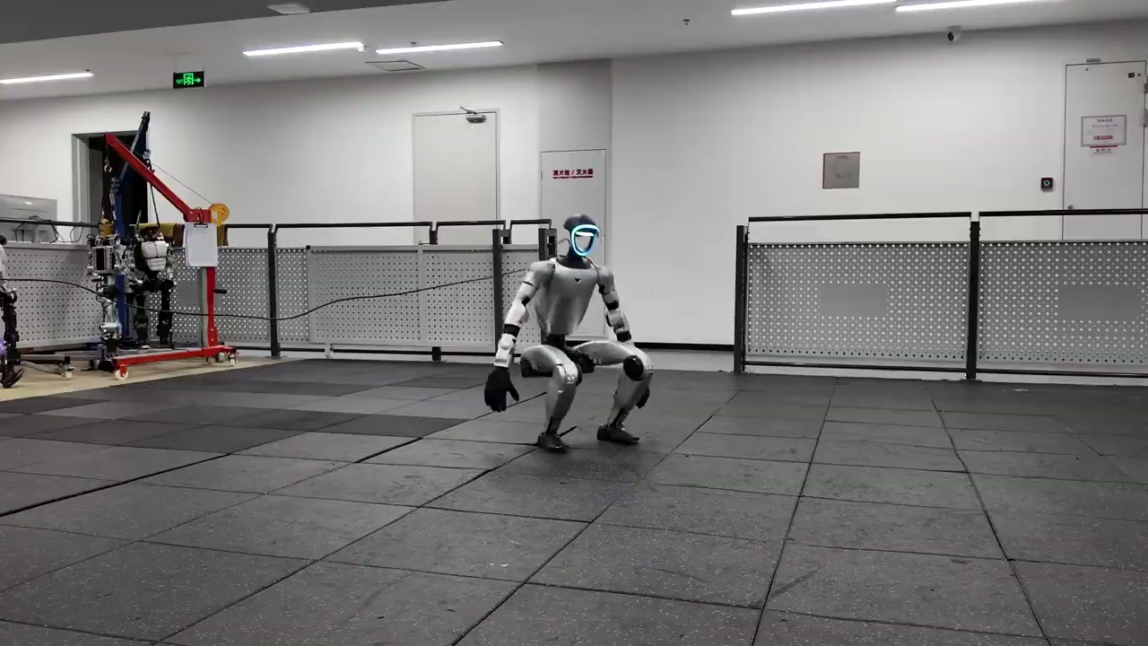
RoboGPC: adapt a motion prior
Regular steering
Stylized steering
RL for joystick steering
Learn a style, then RL for steering
HUMANOID CONTROL / 45 OF 51
Notes:
80–83 min (3 min).
Compare regular steering (left) with squatting-style steering (right), in separate hardware trials at original speed. Regular steering uses RL for the commanded travel velocity and facing direction. Stylized steering first uses supervised adaptation to squatting motion, then RL for the steering task. CoLA adapters are trained while the base controller remains frozen. Contrast this with Metatron, where the demonstrated tasks change goals without new motor-policy training. Course video copies are in the shared Drive folder; do not include the anonymous source website link.

Slide 46
RoboGPC: from motion data to task control
1 LEARN CODES
Reference
+ state
Encoder
Quantize
(FSQ)
2
0
3
Decoder
+ state
Joint
targets
Motion-tracking RL
Codes
Round to
fixed levels
2 LEARN A PRIOR
Robot state
Transformer prior
2
0
3
Decoder
+ state
Joint
targets
Predict tracker codes
Codes
Frozen
3 ADAPT
Task goal
+ state
Frozen prior
+ trainable adapters
2
0
3
Decoder
+ state
Joint
targets
Task-reward RL
Codes
Frozen
HUMANOID CONTROL / 46 OF 51
Notes:
First, PPO trains an encoder and action decoder through a finite scalar quantization (FSQ) bottleneck using motion-tracking rewards. The colored blocks represent discrete motion codes, not named tasks or a prescribed sequence of behaviors. Second, freeze that encoder and decoder. Collect robot observations and codes, then train a transformer by next-token prediction to model the code distribution conditioned on the current robot state. Autoregression is over code groups within a control step, not a long-horizon motion plan. The decoder combines these codes with proprioception to output PD joint targets. Third, insert task-conditioned CoLA adapters into the frozen transformer. Train only these small adapters with supervised learning and/or RL, regularizing toward the pretrained prior. For example, a steering adapter receives velocity and heading commands. Domain randomization supports deployment. Connect to the previous lessons on motion tracking, reusable priors, observation interfaces, and task rewards. Source: the supplied RoboGPC draft, Method Sections 3.1–3.4. No anonymous project link is included.

Slide 47
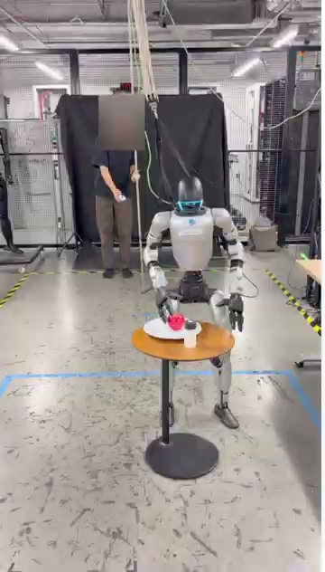
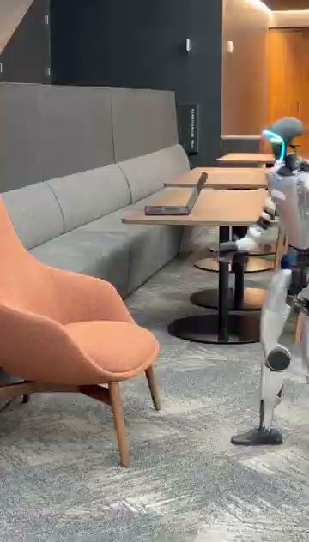
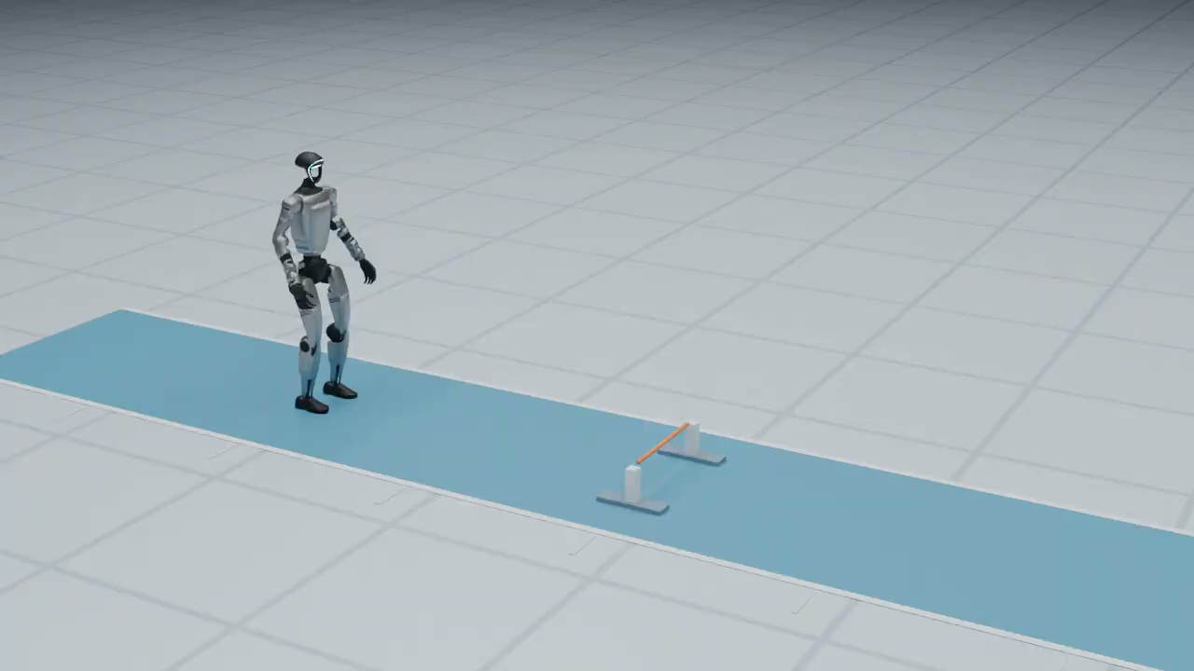
Metatron: new goals, same frozen controller
Timed body goals
Hands + steering
Scene + body goals
Hurdles · MuJoCo simulation
Teleoperation · real G1
Sit and stand · real G1
HUMANOID CONTROL / 47 OF 51
Notes:
83–86 min (3 min).
Metatron distills a dense motion tracker into a controller that accepts partial motion goals. Skill code provides goals while the motor policy stays fixed. Left: timed body goals for hurdles in MuJoCo simulation. Middle: hand targets and steering for teleoperation on physical G1. Right: scene geometry and torso/foot goals for sitting on a chair and standing up on physical G1. The sitting demonstration starts near the furniture with its geometry supplied; it does not show autonomous object discovery or navigation. All three use the same trained G1 controller, without task-specific motor-policy retraining. Humans or coding agents can author the skills offline; the runtime skills are ordinary code. Connect these examples to goal interfaces, state-distribution coverage, and scene conditioning. Public project: https://metatron.lfy.nvidia.com/

Slide 48
Metatron: learn motion, then prompt
1 TRAIN A TRACKER
2 MASK + DISTILL
3 FREEZE + PROMPT
Use RL to follow
full-body motion.
Roll out the student.
Imitate the tracker.
Skill code supplies
partial motion goals.
Full future motion
Mask selected goals
Skill code
e.g., velocity + foot goals
↓
↓
↓
Dense tracker
Generative student
Metatron (frozen)
Motion-tracking reward
Imitate tracker actions
Joint targets from feedback
Metatron · dense tracking → masked distillation → runtime skills
HUMANOID CONTROL / 48 OF 51
Notes:
Train a dense motion tracker with PPO on complete reference motions. Freeze the tracker and train a generative student through masked on-policy distillation: mask selected reference goals, run the student, and ask the tracker for target actions at the states actually reached. This connects to the DAgger discussion, although the full method uses a conditional VAE and a privileged training encoder. The tracker labels the current state; it does not simply replay actions from the original motion. At deployment, only the distilled controller is used, with proprioception and partial motion goals. Gray prompt blocks mean unspecified, not zero. Goals can include selected body poses and arrival times, velocity, heading, style, and scene geometry; multiple types can be combined. A skill is ordinary stateful code that updates these goals. Humans or coding agents can write and test skills offline, while runtime execution does not require an LLM call at each control step. New skills operate within the policy’s learned capabilities, without task-specific motor-policy training. In contrast, RoboGPC learns task adapters. Public project: https://metatron.lfy.nvidia.com/

Slide 49
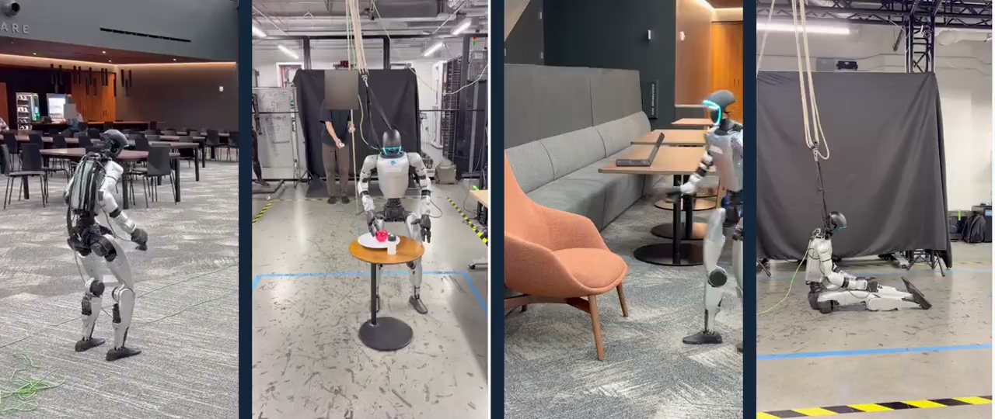
Any questions?
Notes:
88–90 min (2 min).
Close with curiosity rather than a submission checklist. We have tried a small part of robotics: connecting observations, actions, motion data and training conditions to the behavior of a simulated humanoid. There is nothing to hand in and no grading. Invite students to think about what surprised them and one change they would like to try next; no pair discussion or group reports are needed. Perception, manipulation, different bodies and real-robot deployment open many further questions. The course gives them a starting point, not a complete robotics education. Point them to the optional experiments, ProtoMotions documentation and linked papers in the guide.

